Slide 1
Trusted Execution Environments
Chester Rebeiro
IIT Madras
Some of the slides borrowed from Intel; CDACH; ARM

Slide 2
Previously in SSE…
We looked at techniques to run an untrusted code safely
System
Run Program Here
If misbehaves
Kill it
Confinement

Slide 3
Today in SSE…
We now look at how to run sensitive code in an untrusted environment
Besides other applications, the OS can also be untrusted.
Attackers can probe hardware
What to worry about:
Code / Data of the sensitive app gets read / modified by the system
Untrusted System
Run Sensitive
Program Here
Trusted Execution Environment

Slide 4
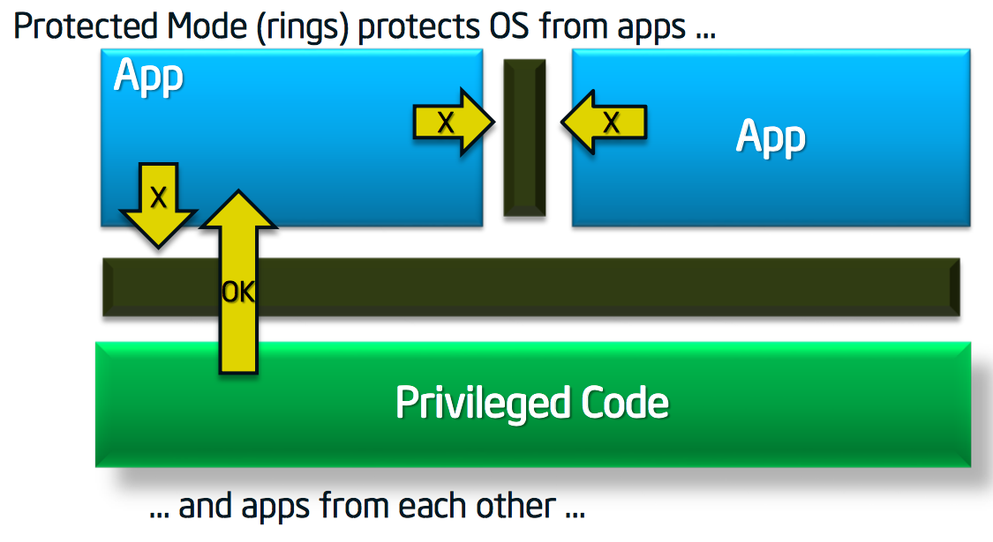
Basic Problem (Ring Architecture)

Slide 5
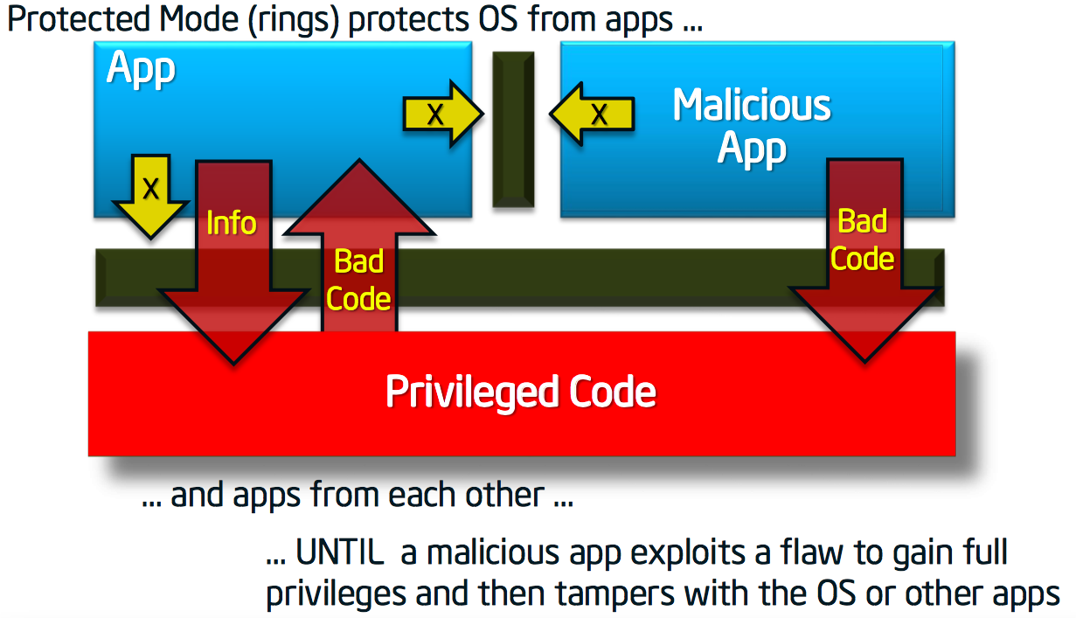
Basic Problem (Ring Architecture)

Slide 6
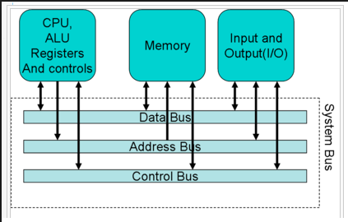
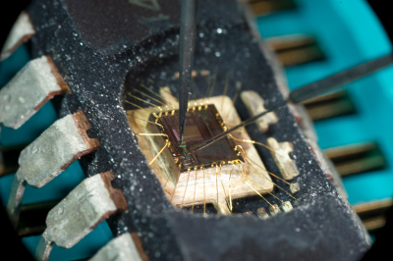
Invasive Attacks

Slide 7
Trusted Execution Environments
Achieve confidentiality and integrity even when the OS is compromised!
ARM : Trustzone (trusted execution environments)
Intel : SGX (enclaves)

Slide 8
ARM Trustzone
Trustzone Security Whitepaper, ARM
http://infocenter.arm.com/help/topic/com.arm.doc.prd29-genc-009492c/PRD29GENC-009492C_trustzone_security_whitepaper.pdf
Some of the slides borrowed from CDACH; ARM

Slide 9
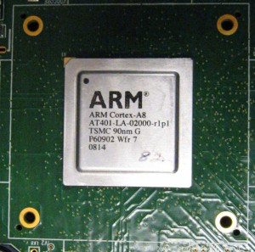
ARM System on Chips

Slide 10
ARM Trustzone (Main Idea)
Hardware and Software partitioned into two: Normal and Secure worlds
A single hardware processor timesliced between secure and normal worlds
Secure world provides an environment that supports confidentiality and integrity.
Can prevent software attacks
Cannot prevent invasive attacks

Slide 11
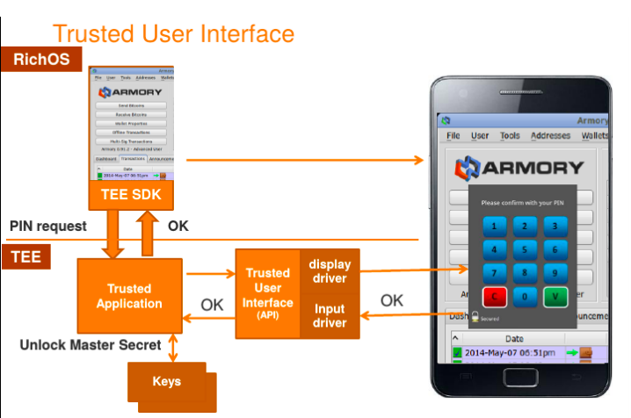
A Typical Trustzone Application

Slide 12
Switching Worlds
Execution in time sliced manner (Secure <-> Normal)
New mode (monitor mode) that is invoked during switching modes
Mode switching
triggered by secure monitoring call (SMC) instruction
certain hardware exceptions (interrupts, aborts)
Monitor Mode: saves state of the current world and restores the state of the world being switched to. Restoration by return-from-exception.
NS Bit: in configuration register indicates secure / normal operating mode.
NS = 1 -> indicates non-secure (normal) mode

Slide 13
NS Bit extends beyond the chip

Slide 14
NS Bit extends beyond the chip

Slide 15
Memory Management
Non Secure Table Identifier
current state of the processor (0 if secure world / 1 if normal
world
If NSTID = 1 then force NS bit to 1
CPU Core
Memory (RAM)
Virtual address (VA) have an extra bit (33-rd bit) to
VA NSTID
page tables
MMU
Physical address
page tables
Physical address
Notes:
Non Secure Table Identifier --- current state of the processor

Slide 16
Memory Management
TLB stores NSTID and NS bit per entry
CPU Core
Memory (RAM)
VA NSTID
page tables
VA NSTID
PA NS
VA NSTID
PA NS
MMU
Physical address
VA NSTID
PA NS
VA NSTID
PA NS
page tables
TLB
Page walk only
on TLB miss
Physical address
Notes:
Non Secure Table Identifier --- current state of the processor

Slide 17
Memory Management
CPU Core
Memory (RAM)
Secure world page tables can map to normal world memory
VA NSTID
page tables
VA NSTID
PA NS
VA NSTID
PA NS
MMU
Physical address
VA NSTID
PA NS
VA NSTID
PA NS
page tables
TLB
Page walk only
on TLB miss
Physical address
Notes:
Non Secure Table Identifier --- current state of the processor

Slide 18
Memory Management
CPU Core
Memory (RAM)
Cache Memory
Tag NS
cache line
Tag NS
cache line
Tag NS
cache line
Tag NS
cache line
Access RAM only on cache miss
PA
VA NSTID
page tables
VA NSTID
PA NS
MMU
VA NSTID
PA NS
VA NSTID
PA NS
page tables
VA NSTID
PA NS
TLB
Page walk only
on TLB miss
Notes:
Non Secure Table Identifier --- current state of the processor

Slide 19
Memory Management Units
Two virtual MMUs (one for each mode)
Two page-tables active simultaneously
A single TLB present
A tag in each TLB entry determines the mode (Normal and Secure TLB entries may co-exist; this allows for quicker switching of modes)
alternatively the monitor may flush the TLB whenever switching mode
A single cache is present
Tags (again) in each line used to store state
Any non-locked down cache line can be evicted to make space for new data
A secure line load can evict a non-secure line load (and vice-versa)

Slide 20
Secure and Normal Devices

Slide 21
Interrupts
Normal world
Secure world
User Code
User Code
Privileged Code
Privileged Code
IRQ
Monitor
IRQ
IRQ
All interrupts routed to monitor first.
Interrupts can be configured to go either to the normal world or secure world.

Slide 22
Interrupts
Normal world
Secure world
Secure World
Interrupt Vector Table
User Code
User Code
Normal World Interrupt Vector Table
Privileged Code
Privileged Code
IRQ
Monitor
Monitor Interrupt Vector Table
IRQ
All interrupts routed to monitor first.
Interrupts can be configured to go either to the normal world or secure world.

Slide 23
Software Architecture
The minimal secure world can just have implementations of synchronous code libraries
Typically has an entire operating system
Qualcomm’s QSEE; Trustonics Kinibi; Samsung Knox; Genode
The secure OS could be tightly couples to the rich OS so that a priority of a task in the rich OS gets mapped accordingly in the secure OS
Advantage of having a full OS is that we will have complete MMU support
Intermediate Options

Slide 24
Secure Boot
Why?
Attackers may replace the flash software with a malicious version, compromising
the entire system.
How?
Secure chain of trust.
Starting from a root device (root of trust) that cannot be easily tampered

Slide 25
Secure Boot Sequence

Slide 26
Chain of Trust
check signature
check signature
Trustlet
Trustlet
Trustlet
Rich OS
check signature
Secure OS
check signature
Boot loader
check signature
Inherently secure
Component
(PUF/ TPM/ onchipROM)
check signature
Root of trust
Notes:
Onchip ROM →

Slide 27

Points to Ponder
Describe how ARM trustzone can handle invasive attacks?
What can it handle?
What are the limitations?

